Slide 1



DATA ANALYST PROJECT[AMRUTA]
View in Power BI
Last data refresh:
9/13/2023 6:58:20 AM UTC
Downloaded at:
9/13/2023 7:43:17 AM UTC

Slide 2
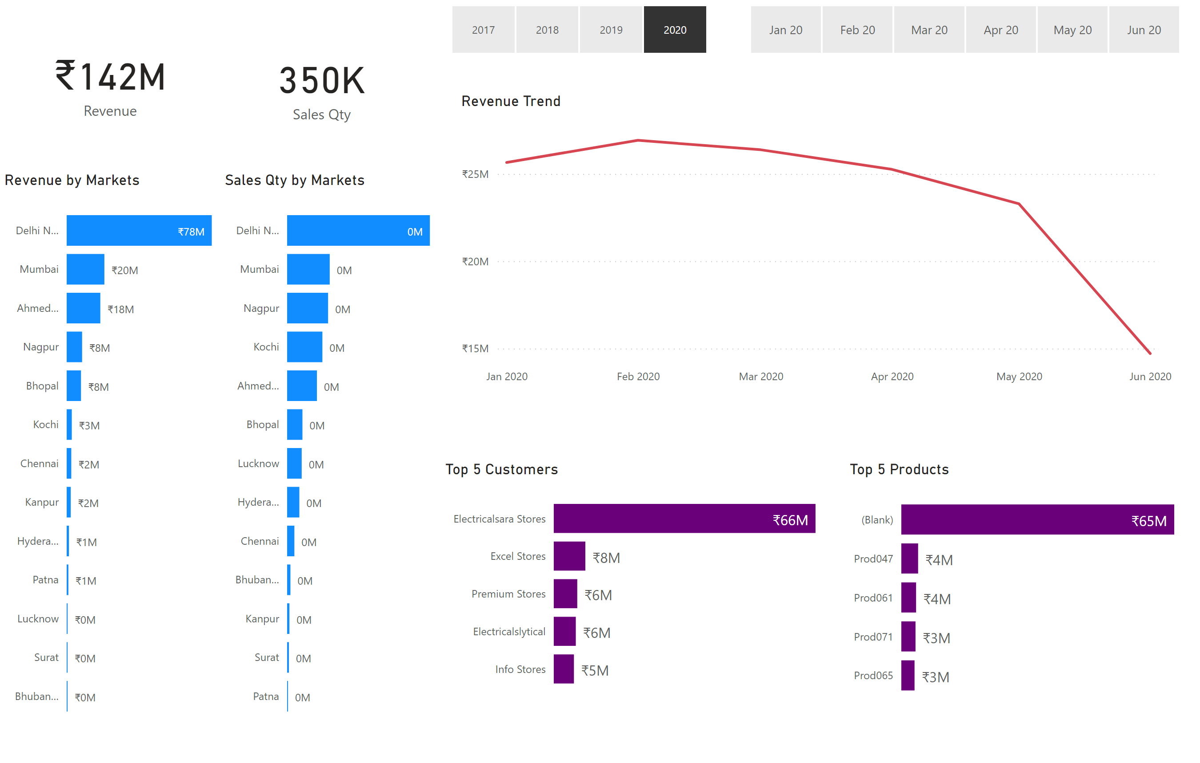
Key Insights
Notes:
card
No alt text provided
card
No alt text provided
Revenue by Markets
No alt text provided
Sales Qty by Markets
No alt text provided
slicer
No alt text provided
slicer
No alt text provided
Top 5 Customers
No alt text provided
Top 5 Products
No alt text provided
Revenue Trend
No alt text provided

Slide 3
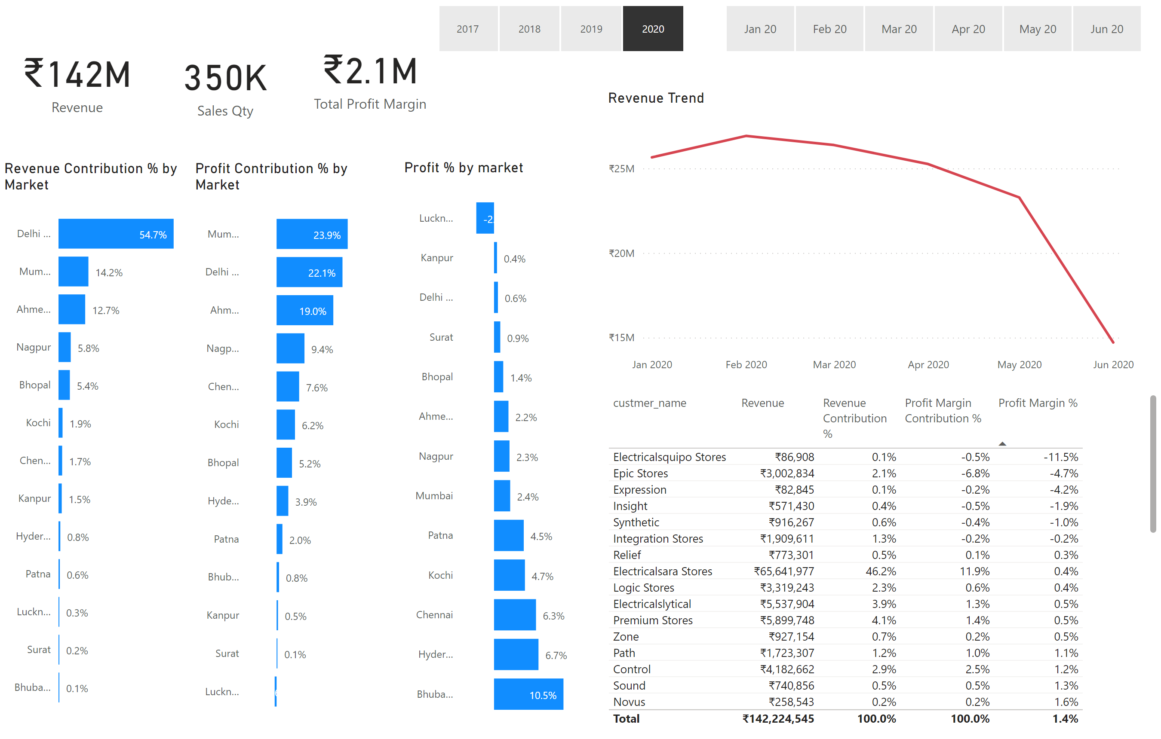
Profit Analysis
Notes:
card
No alt text provided
card
No alt text provided
Profit % by market
No alt text provided
Profit Contribution % by Market
No alt text provided
slicer
No alt text provided
slicer
No alt text provided
Top 5 Customers
No alt text provided
Revenue Trend
No alt text provided
card
No alt text provided
Revenue Contribution % by Market
No alt text provided

Slide 4
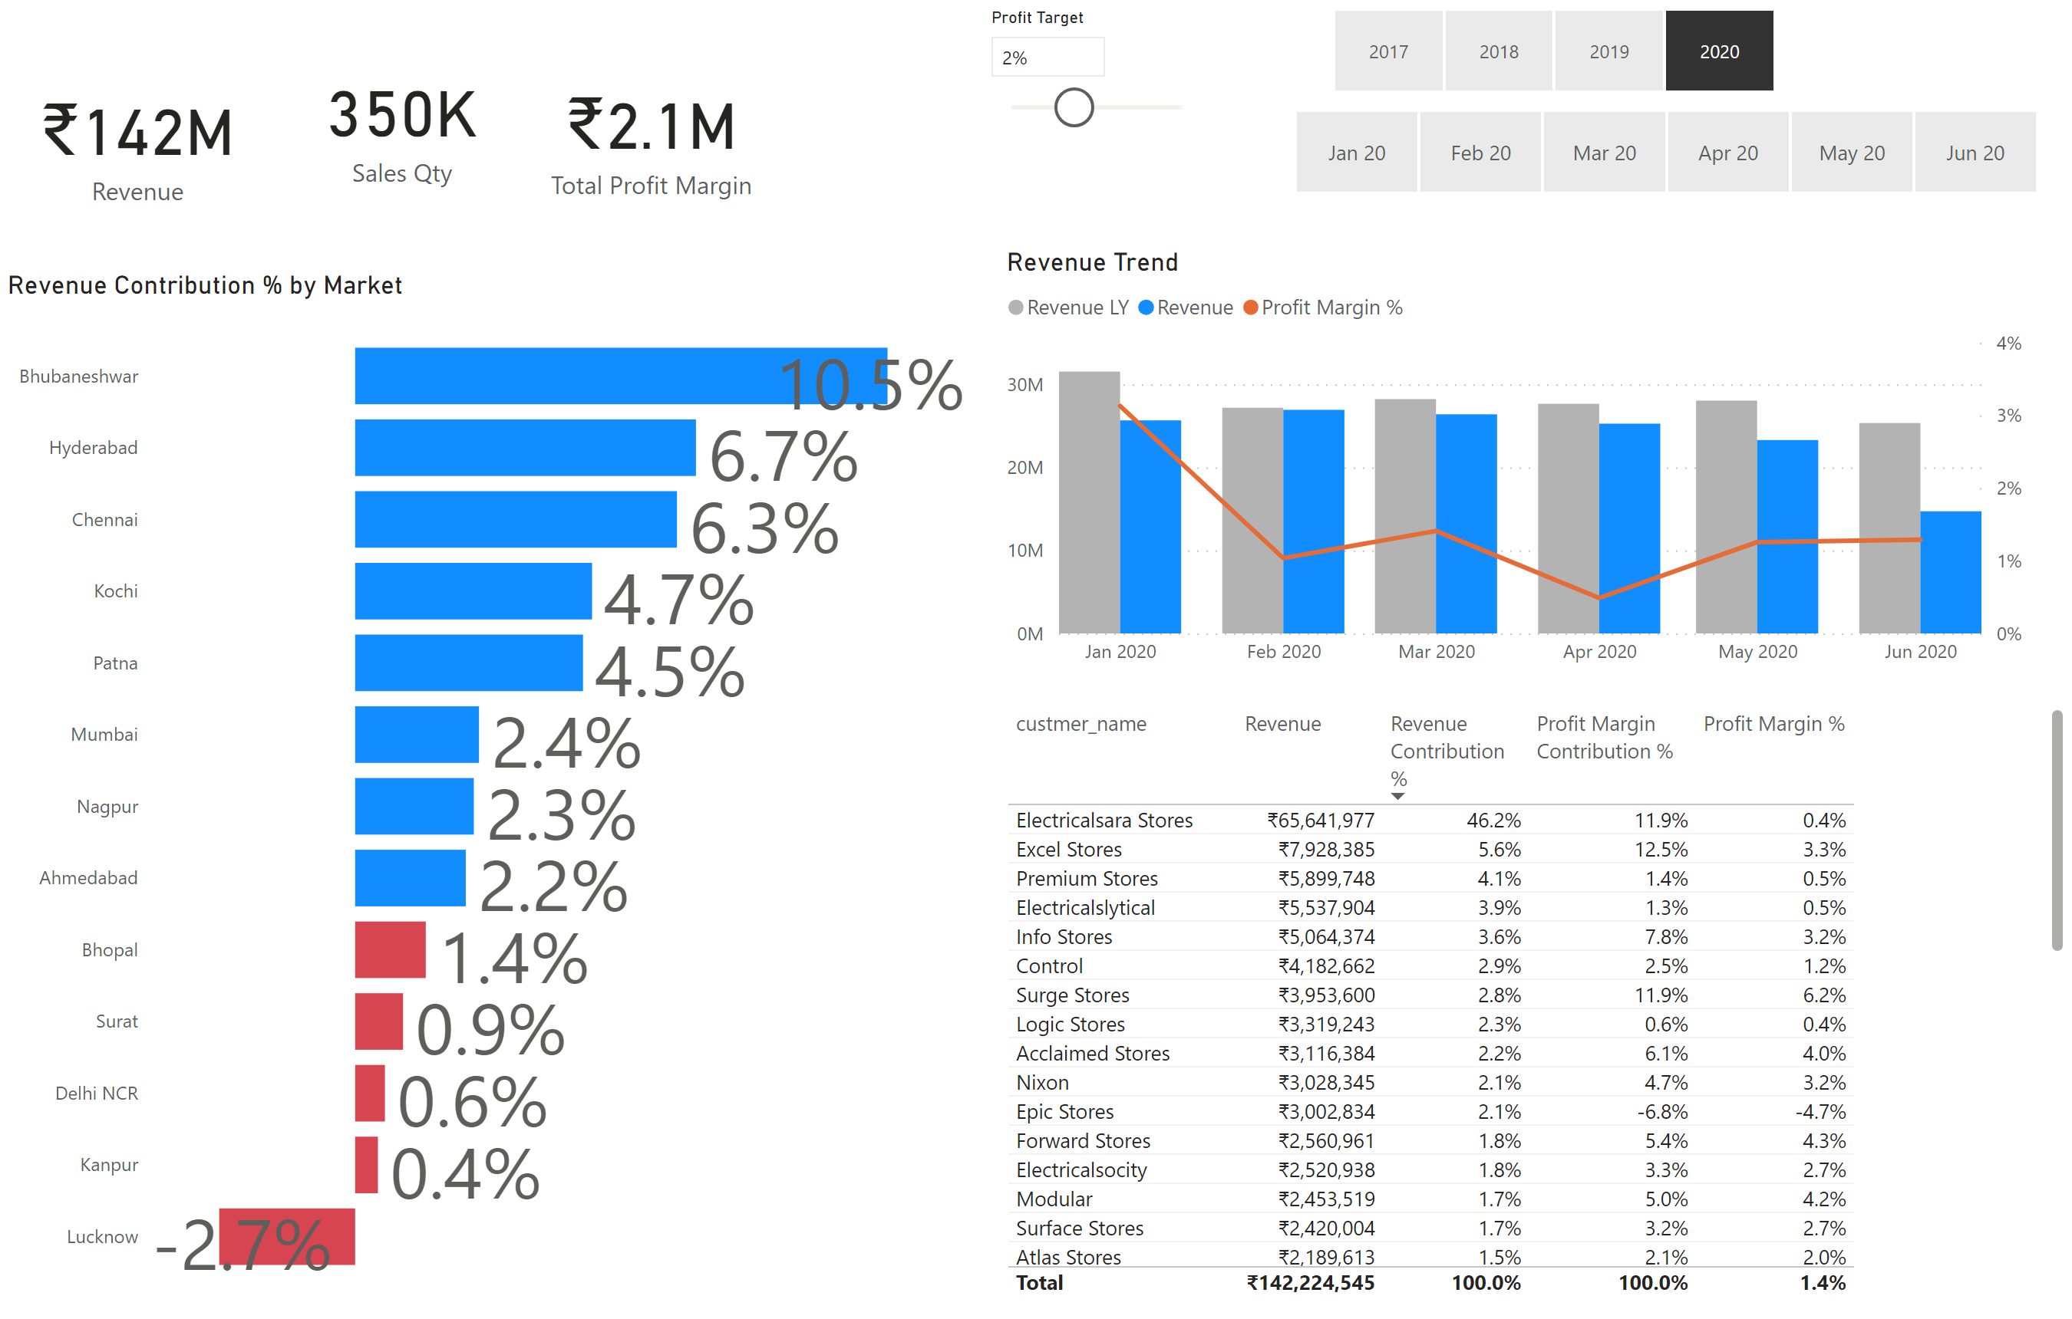
Performance Insights
Notes:
card
No alt text provided
card
No alt text provided
slicer
No alt text provided
slicer
No alt text provided
Top 5 Customers
No alt text provided
Revenue Trend
No alt text provided
card
No alt text provided
Revenue Contribution % by Market
No alt text provided
slicer
No alt text provided

